Slide 1


@tpierrain
From problem space
to solution space (day 2)

Slide 3
Entity Vs. Value type

Slide 4
Entity
-
Have identity and lifecycle
Mutable
Identifier equality

Slide 5
Value type
-
No identity
Immutable
Equality by Properties

Slide 6
Entity
-
Have identity and lifecycle
Mutable
Identifier equality
Value type
-
No identity
Immutable
Equality by Properties

Slide 7
Value type
Powered by “Value”

Slide 9
Closure of operation
-
an operation whose return type is the same as
the type of its Implementer E.g.: Row otherRow = row.AddSeat(seat);

Slide 10
Closure of operation
-
Do you See the benefits?

Slide 11
Closure of operation
-
Foster immutability
Reduce coupling
( easier to “move” Code )
Here, the Coach type stands by itself

Slide 13
Aggregates

Slide 14
Aggregate
-
Collection of objects ( Entities and value types )
treated as a conceptual whole

Slide 15
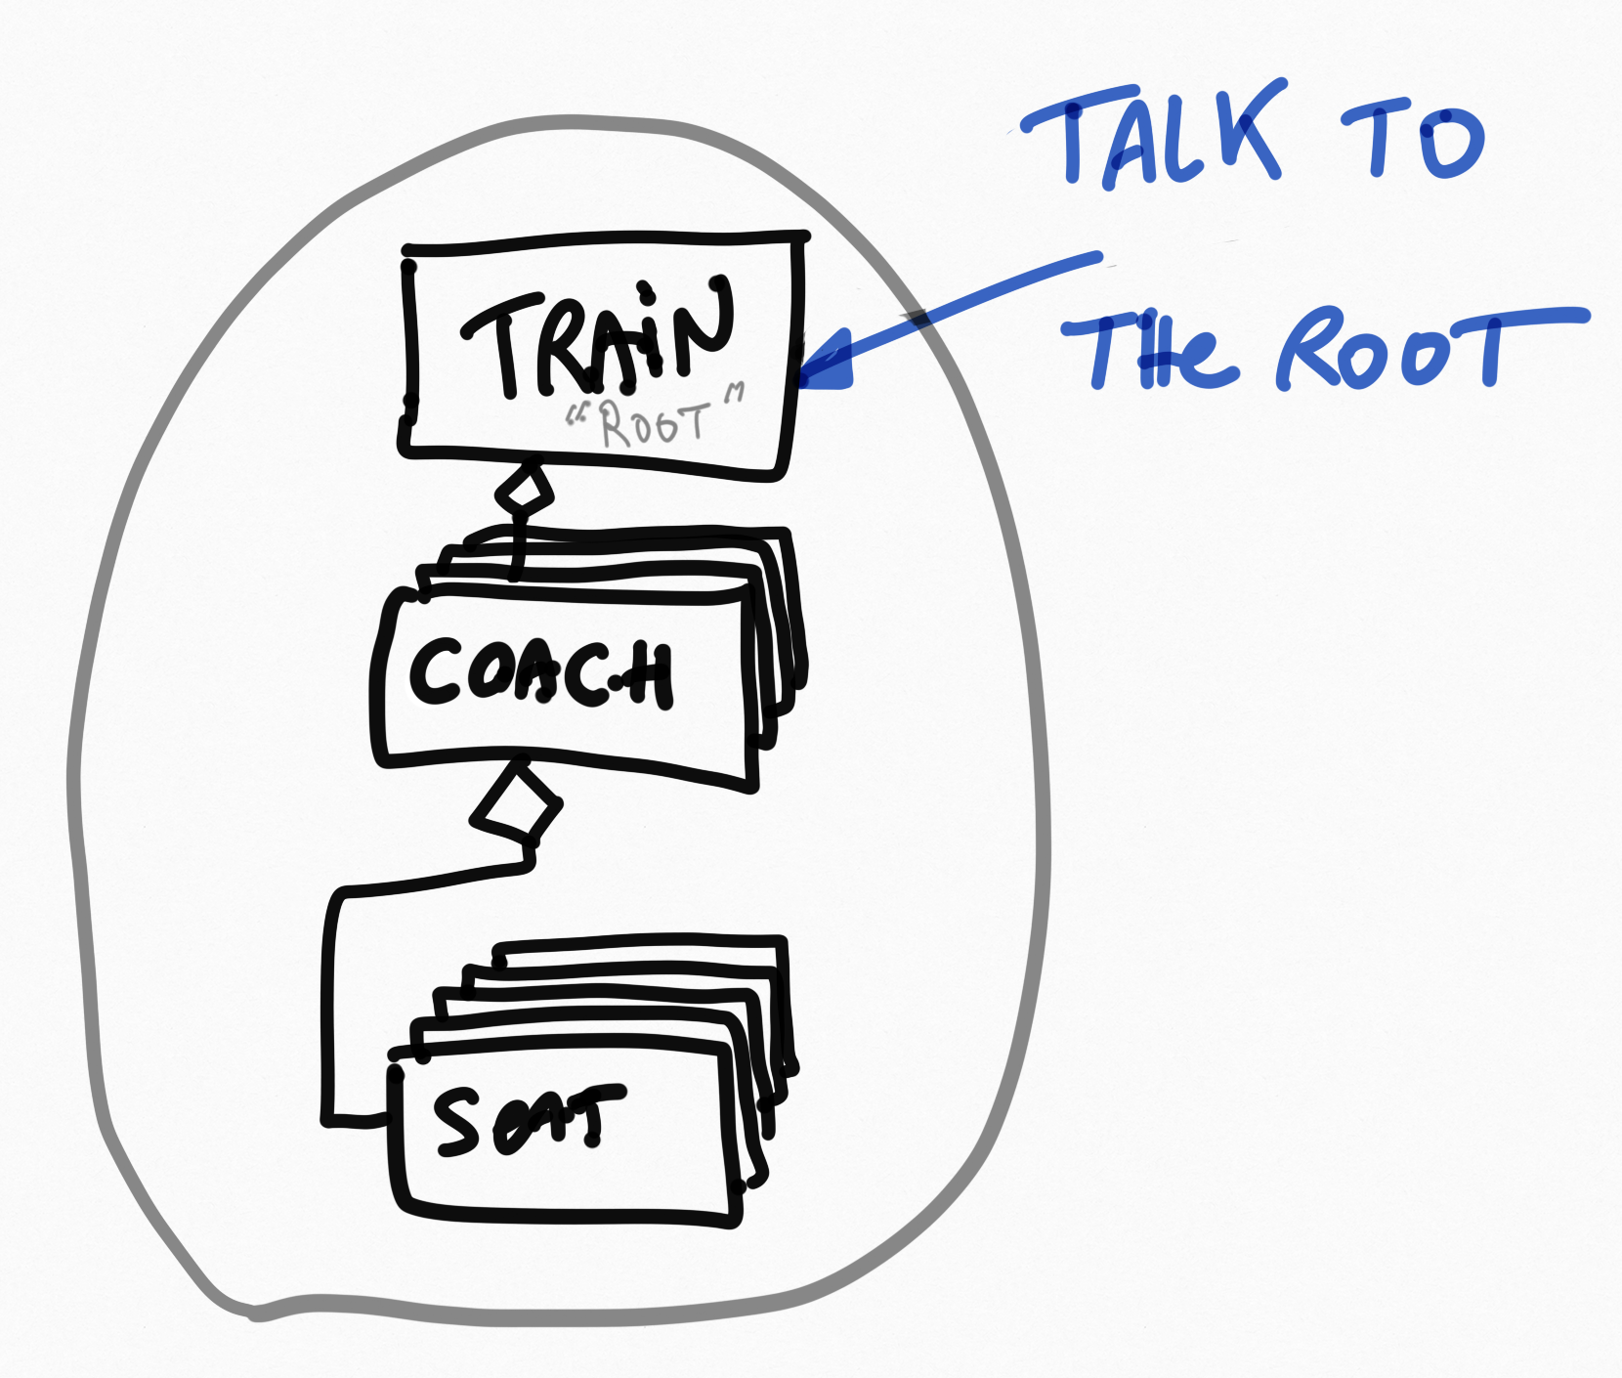
Aggregates needs Invariants

Slide 17
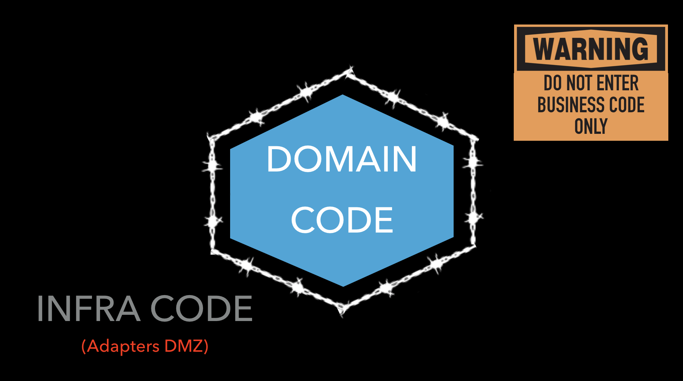
Hexagonal Architecture FTW!

Slide 18
Hexagonal Architecture?

Slide 19
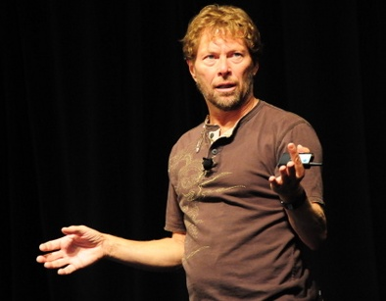
Hexagonal architecture
Alistair Cockburn

Slide 20
Many Benefits
Hexagonal Architecture
Embrace change
TODAY >> Protect your domain code << TODAY
Enforce testability…

Slide 21
Many Benefits
Hexagonal Architecture
Embrace change
TODAY >> Protect your domain code << TODAY
Enforce testability…

Slide 22
Hexagonal Architecture
How?

Slide 23
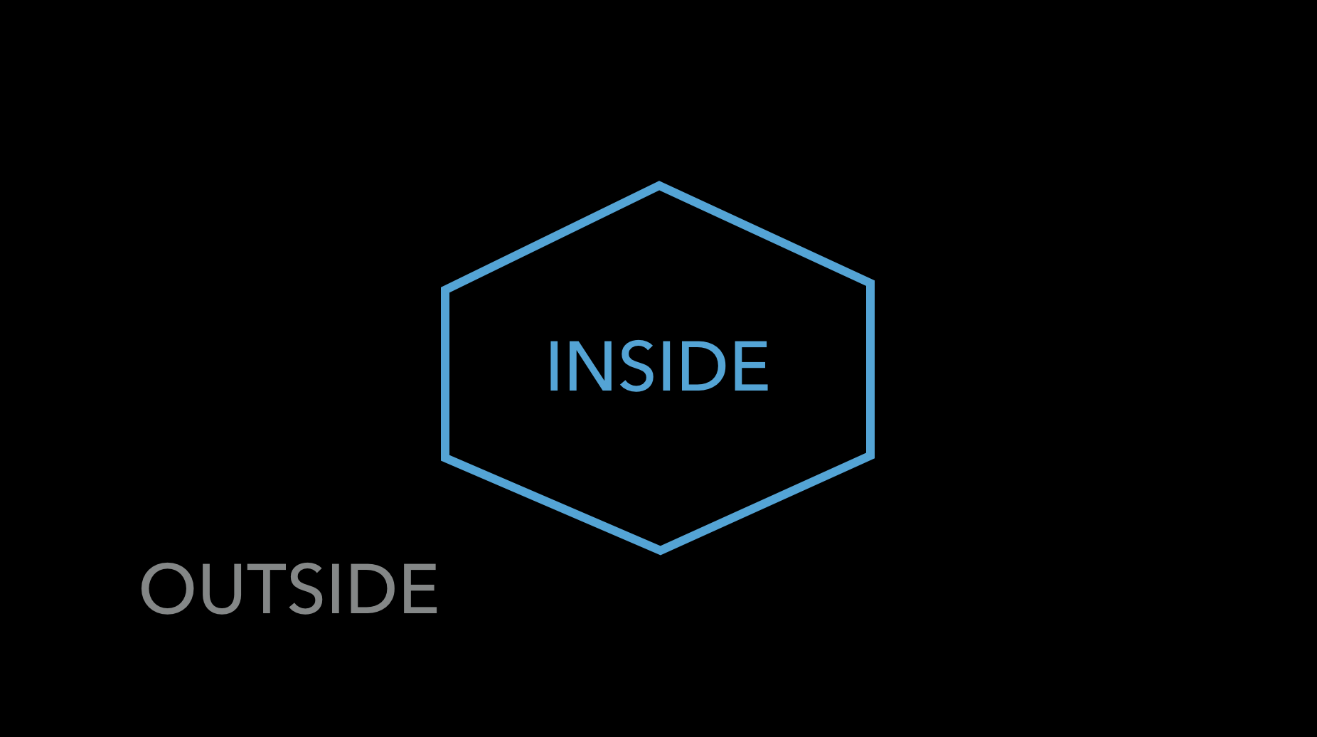
Hexagonal Architecture

Slide 24
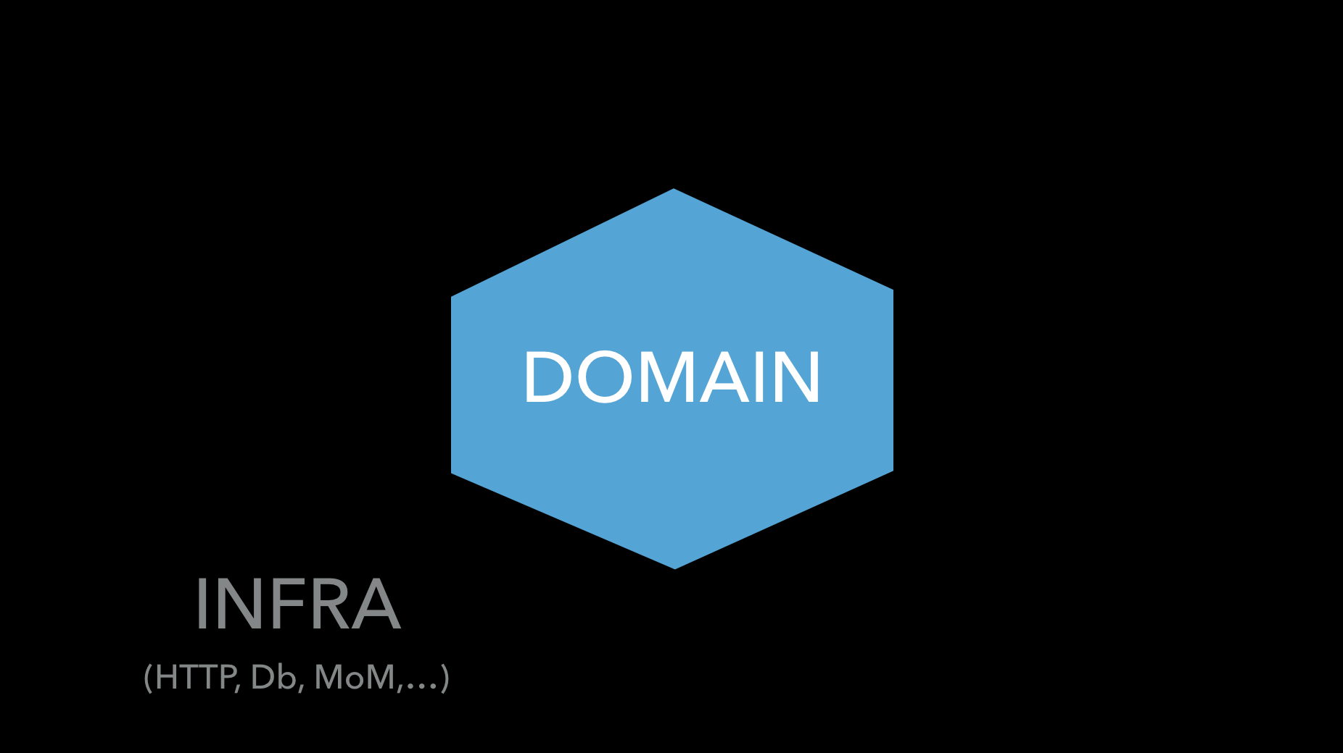
Hexagonal Architecture

Slide 25
Hexagonal Architecture

Slide 26

Hexagonal Architecture

Slide 27
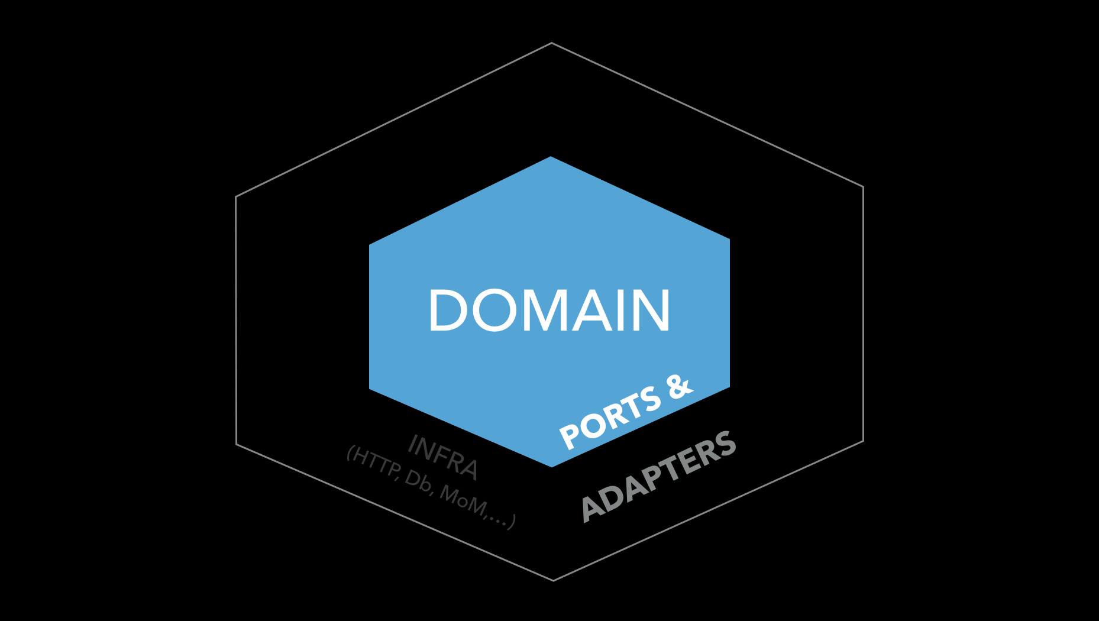
Hexagonal Architecture
Dependencies
Always
Toward
The inside
DIP principle
“Configurable dependencies”

Slide 28
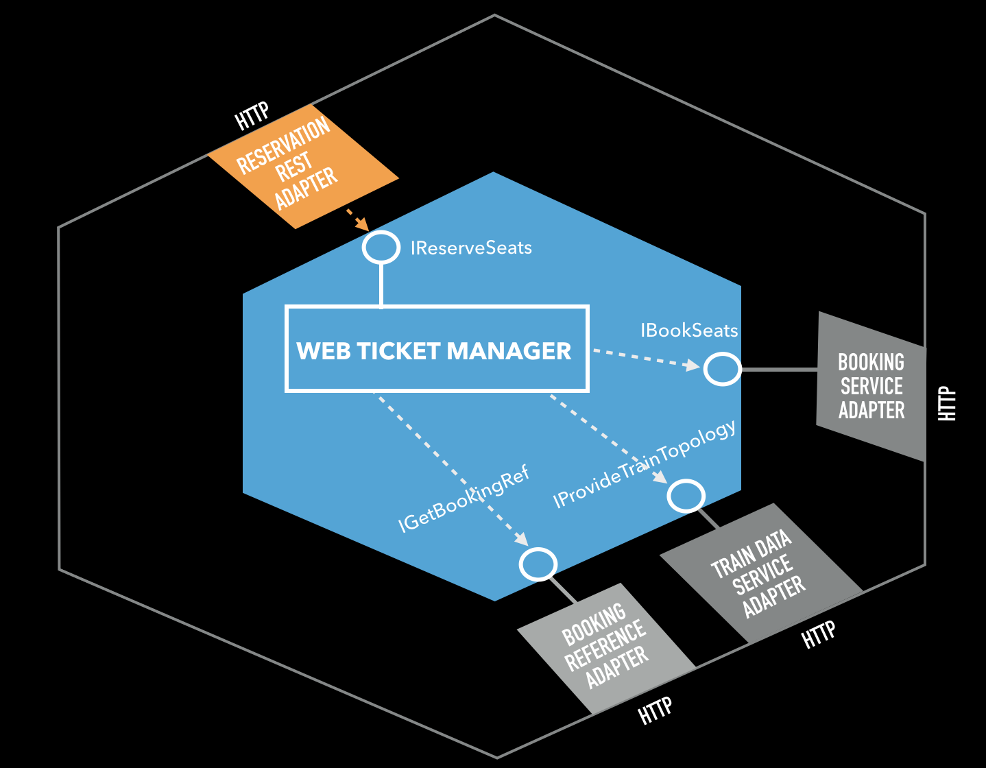
Hexagonal Architecture
PORTS
in the
domain
ADAPTERS
in the
Infra

Slide 29
Hexagonal Architecture
PORTS and ADAPTERS
To go IN
To go OUT

Slide 30
Hexagonal Architecture
A 3 steps initialization The “key ring” metaphor

Slide 31

Hexagonal Architecture
1. Instantiate the ”I need to go out” Adapters
Train Data Service Adapter
Booking Reference Service Adapter

Slide 32
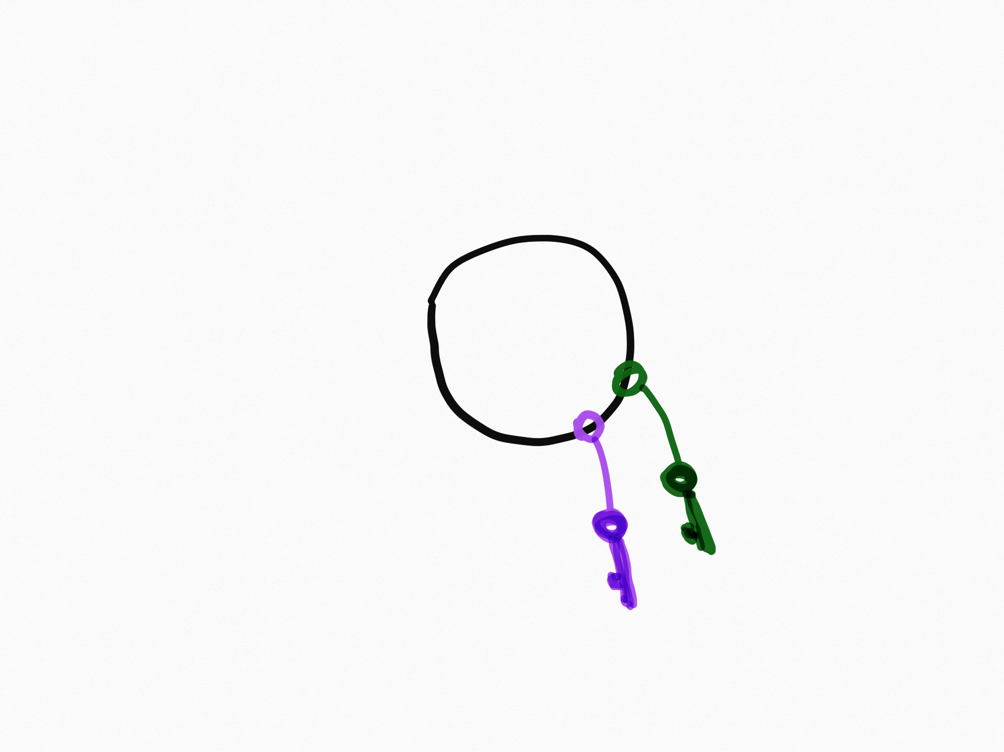
Hexagonal Architecture
2. Instantiate the Hexagon
Web Ticket Manager
Train Data Service Adapter
Booking Reference Service Adapter

Slide 33
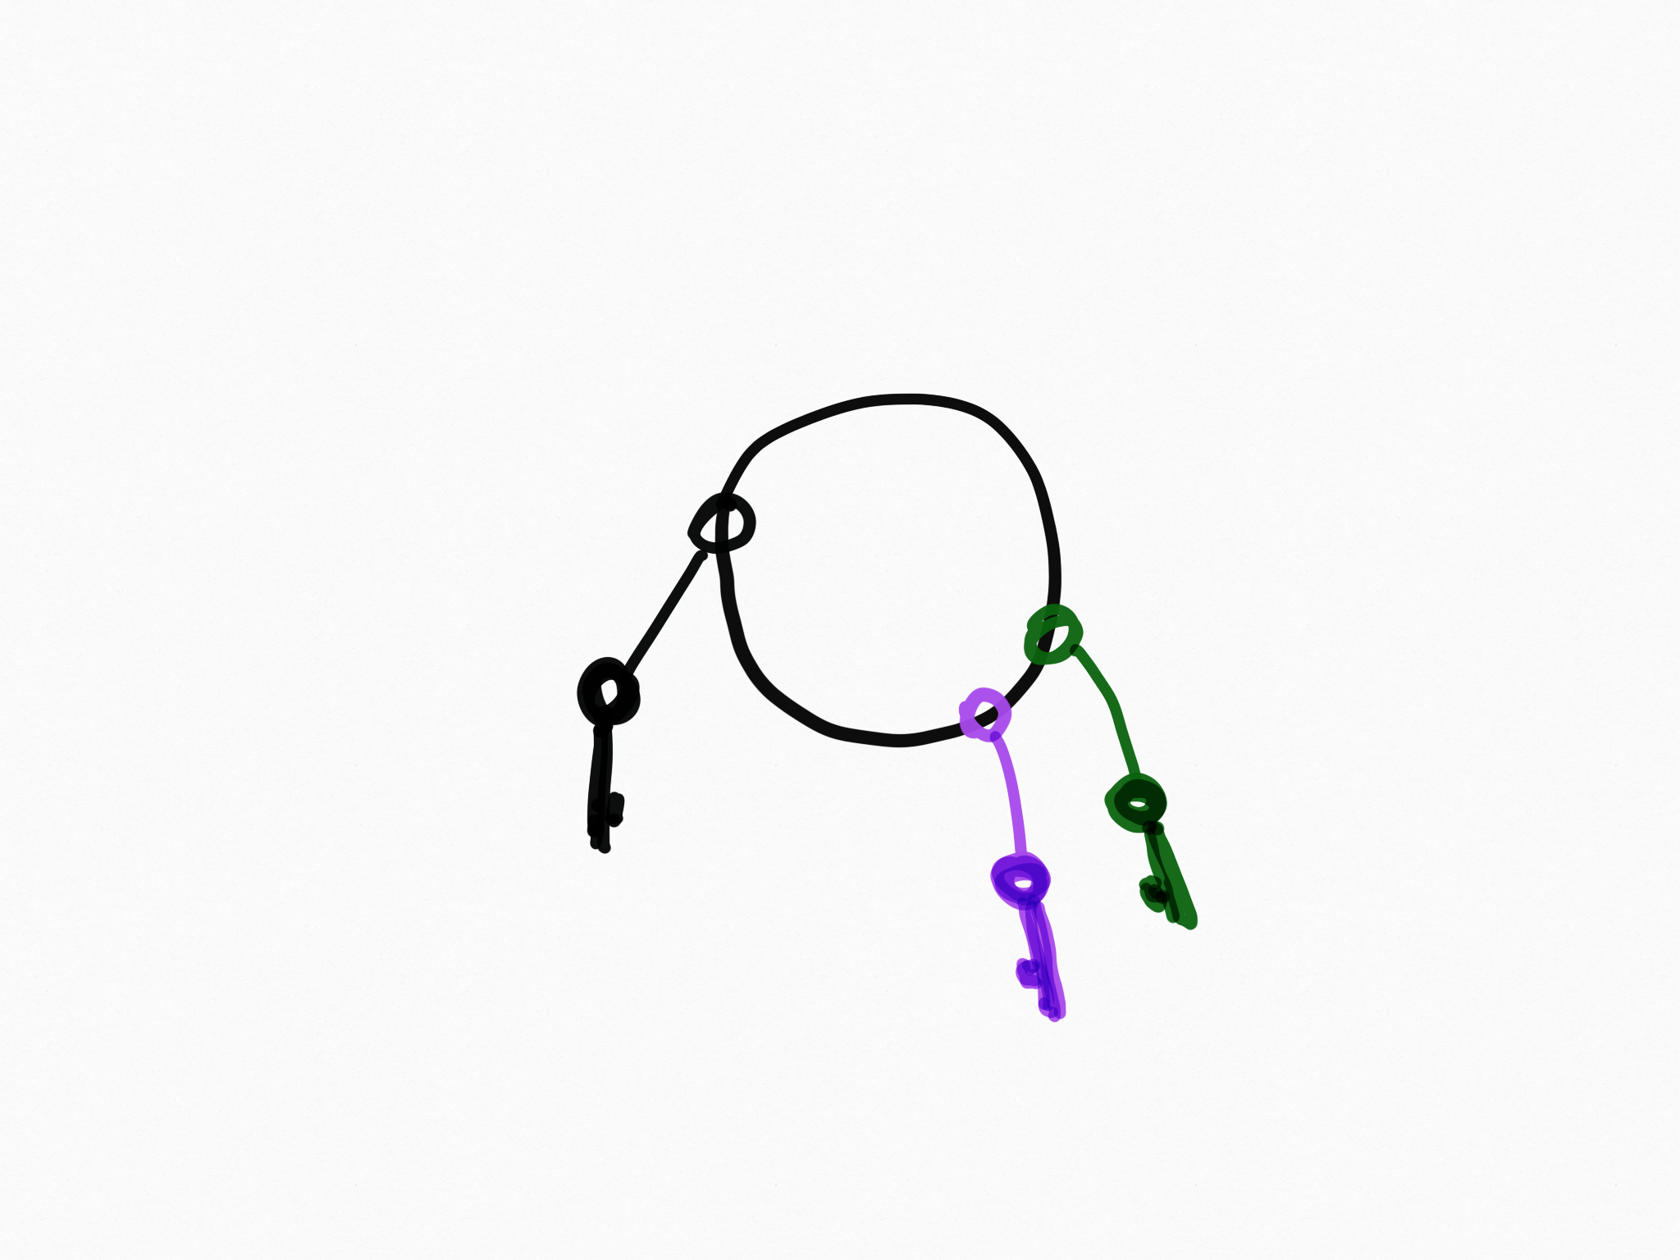
Hexagonal Architecture
3. Instantiate the ”I need to Enter” Adapters
Web Ticket Manager
Train Data Service Adapter
Reservation REST Adapter
Booking Reference Service Adapter

Slide 34
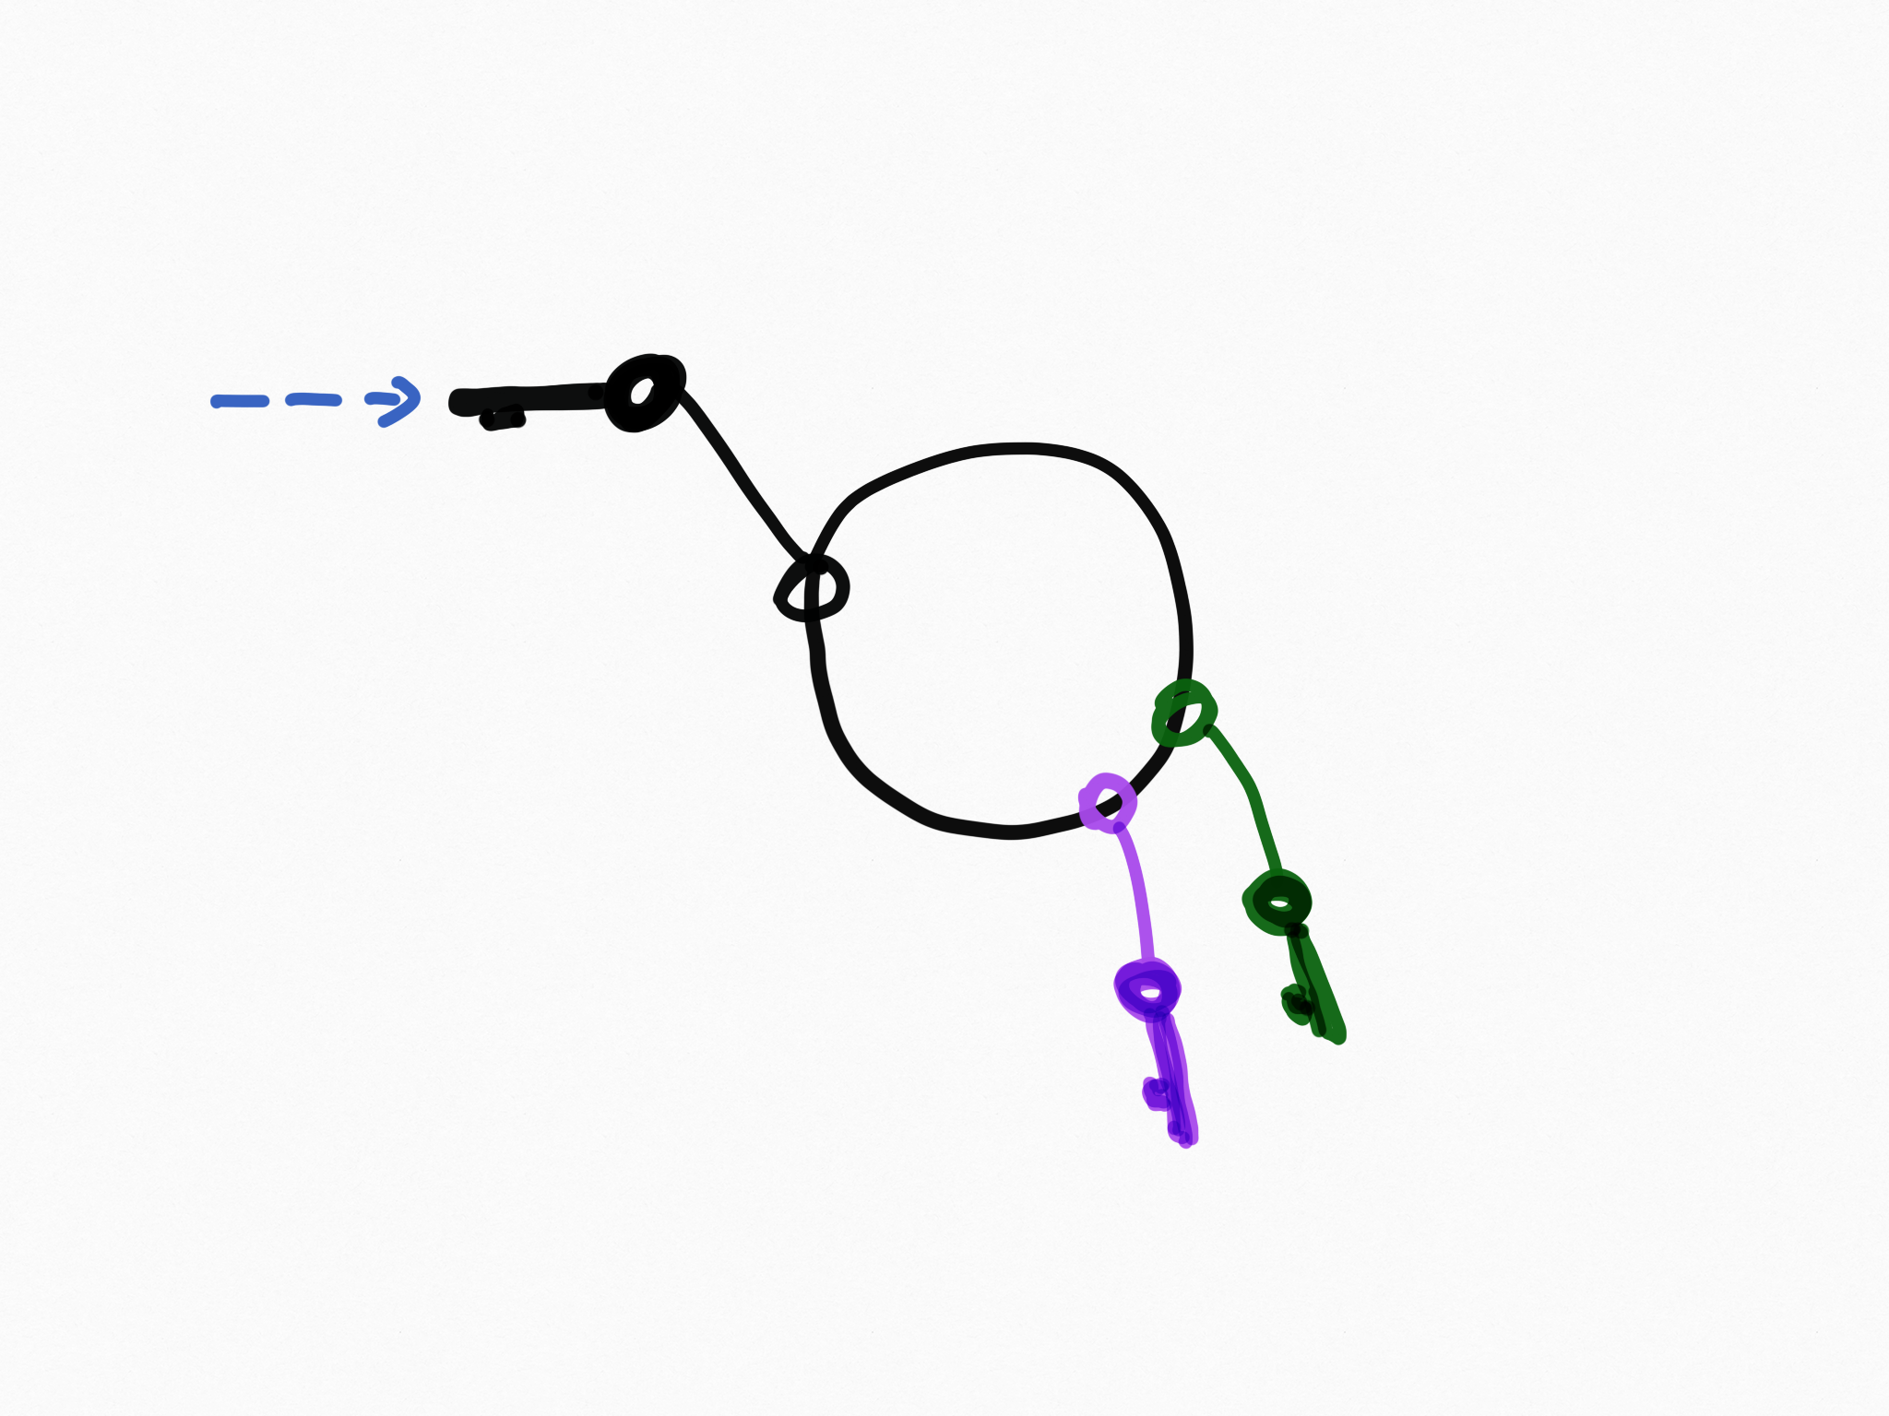
Hexagonal Architecture
All you keep in “your hand”
Reservation REST Adapter
Web Ticket Manager
Train Data Service Adapter
Booking Reference Service Adapter

Slide 35
Hexagonal Architecture
All you keep in “your hand”
Seat Reservation Adapter
Web Ticket Manager
Train Data Service Adapter
Booking Reference Service Adapter

Slide 36
Hexagonal Architecture
To Put it differently…

Slide 37
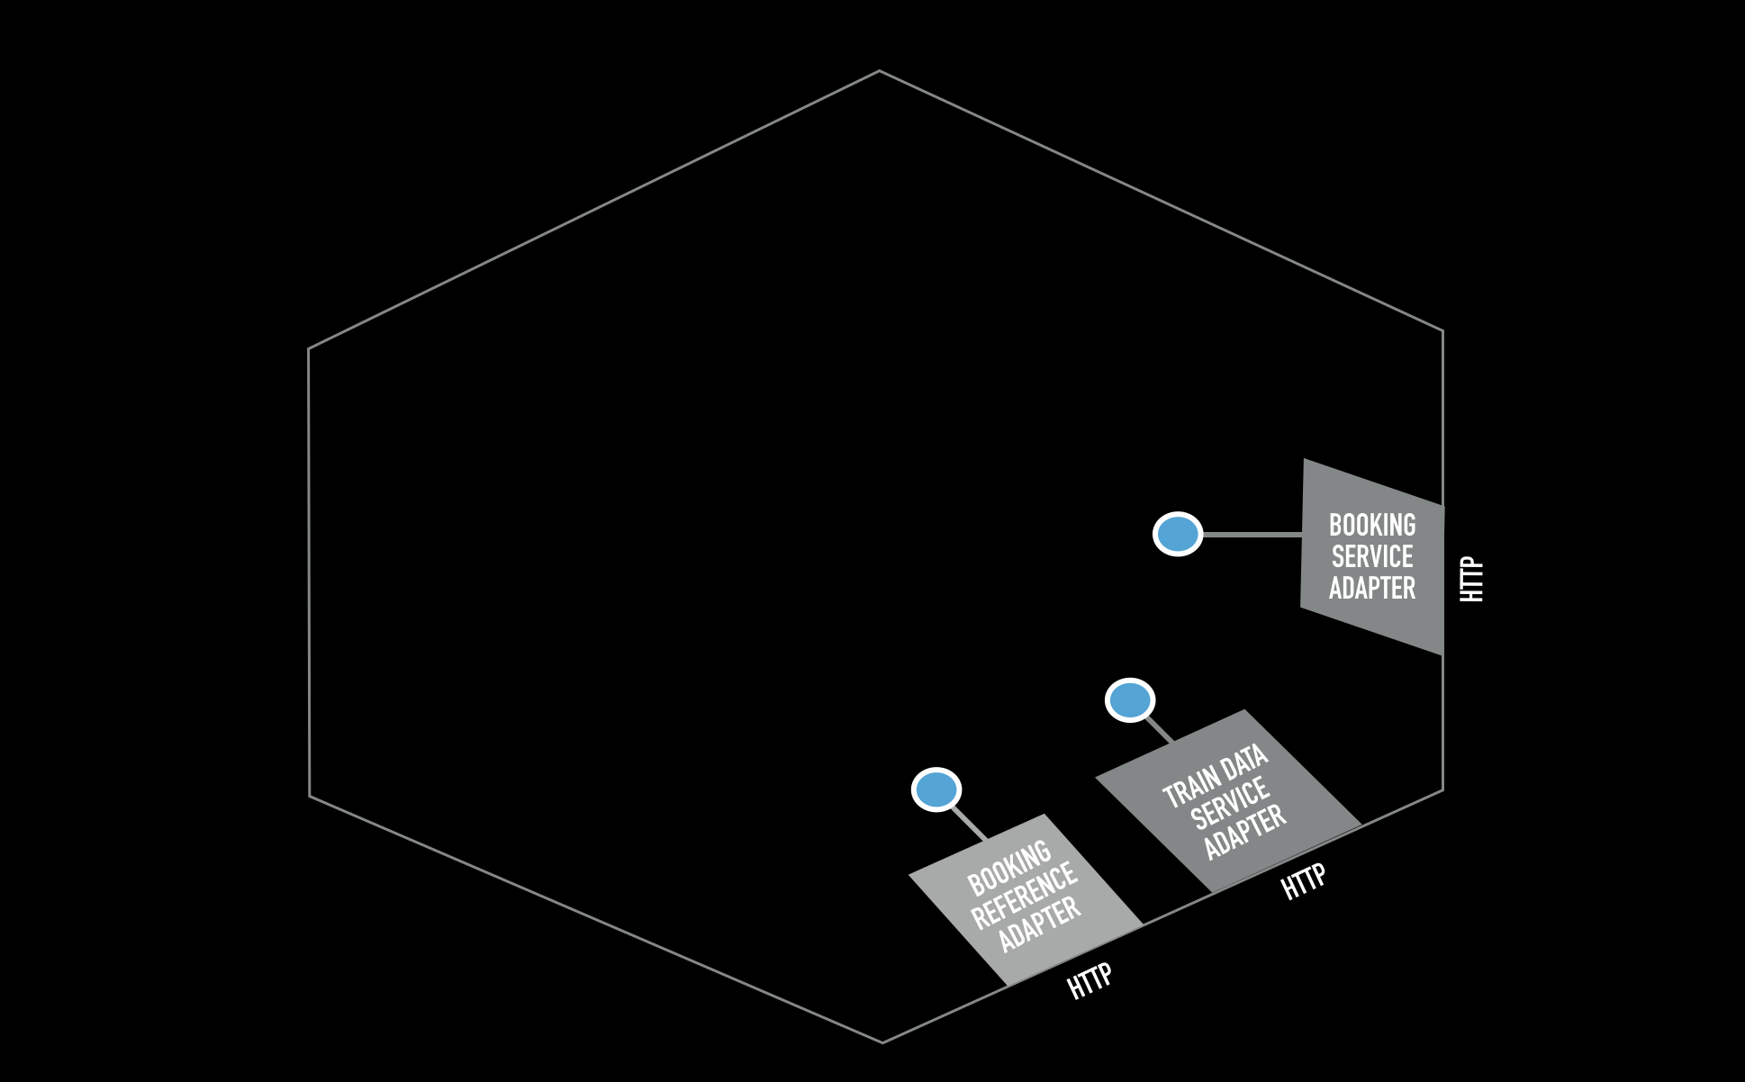
A 3 steps initialization
1. Instantiate the ”I need to go out” Adapters

Slide 38
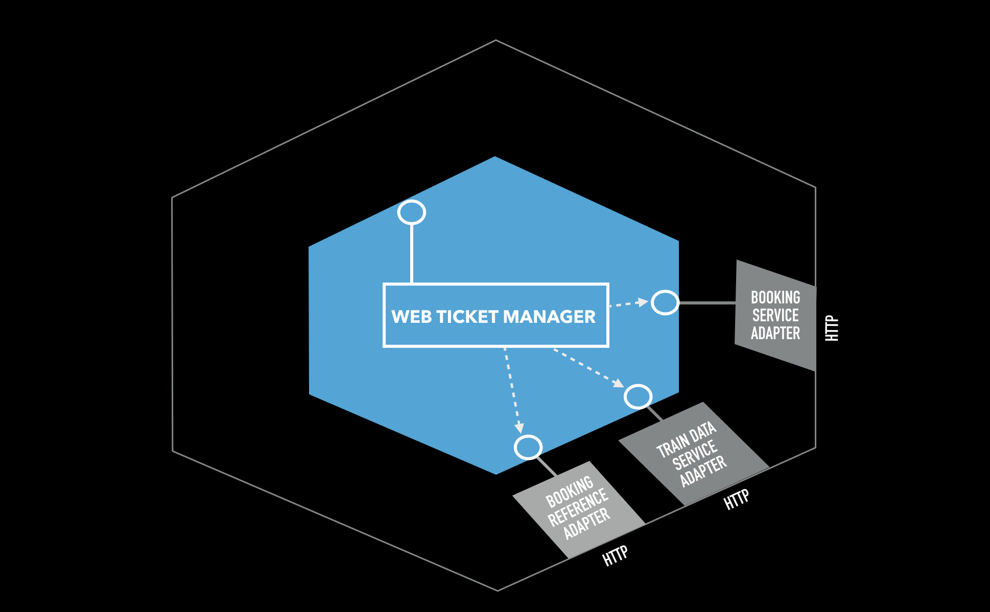
A 3 steps initialization
2. Instantiate the Hexagon

Slide 39
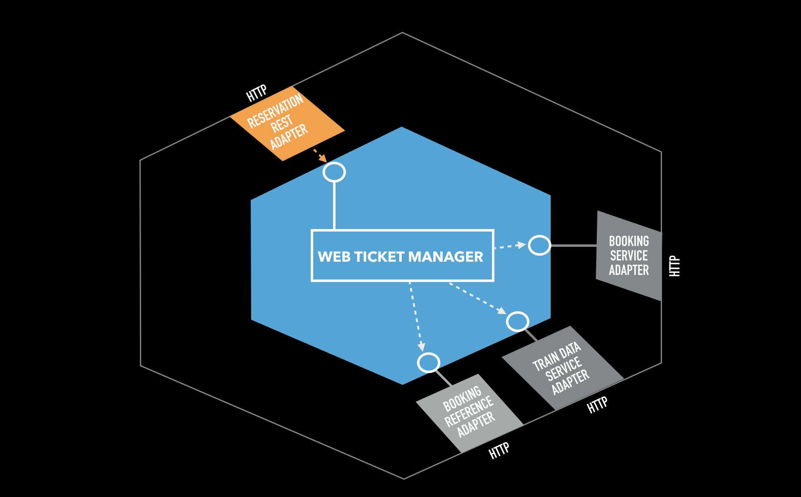
A 3 steps initialization
3. Instantiate the ”I need to Enter” Adapters

Slide 40
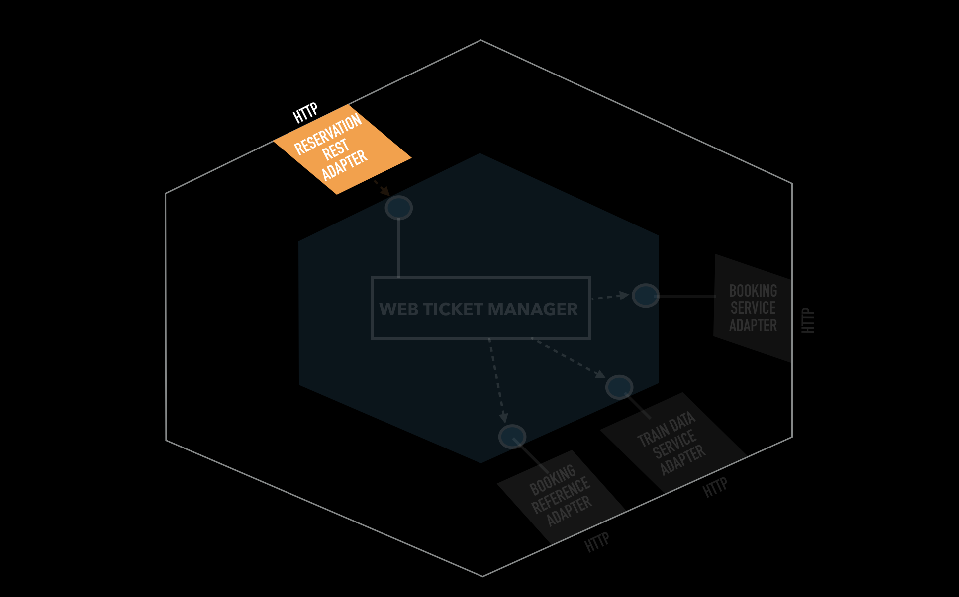
A 3 steps initialization
All you keep in “your hand”

Slide 41
Hexagonal Architecture
Let’s do it!

Slide 42
Hexagonal Architecture

